Slide 1

Complete Explanation On Git And Github

Slide 2

Introduction to Version Control
Version control is a critical tool for software development, allowing developers to track changes to their code over time and collaborate with others on a project. Git is one of the most popular version control systems, providing a powerful set of tools for managing code and collaborating with others.

Slide 3
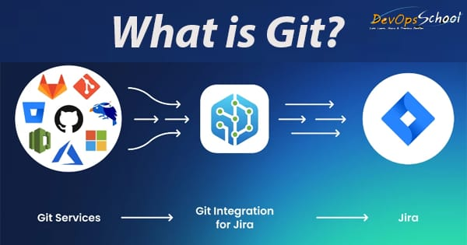
What is Git?
Git is a free and open source distributed version control system designed to handle everything from small to very large projects with speed and efficiency.
It allows multiple developers to work on the same codebase at the same time without overwriting each other's changes.
Git tracks changes to code over time and allows developers to revert back to previous versions of their code if necessary.

Slide 4
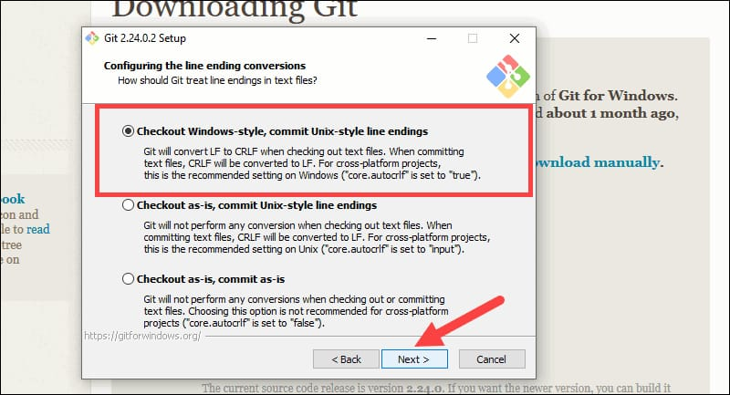
Installing Git
Windows
Download the Git installer from the Git website
Run the installer and follow the prompts
Open Git Bash to start using Git.
Linux
Open the terminal
Run the following command: sudo apt-get update
Run the following command: sudo apt-get install git

Slide 5
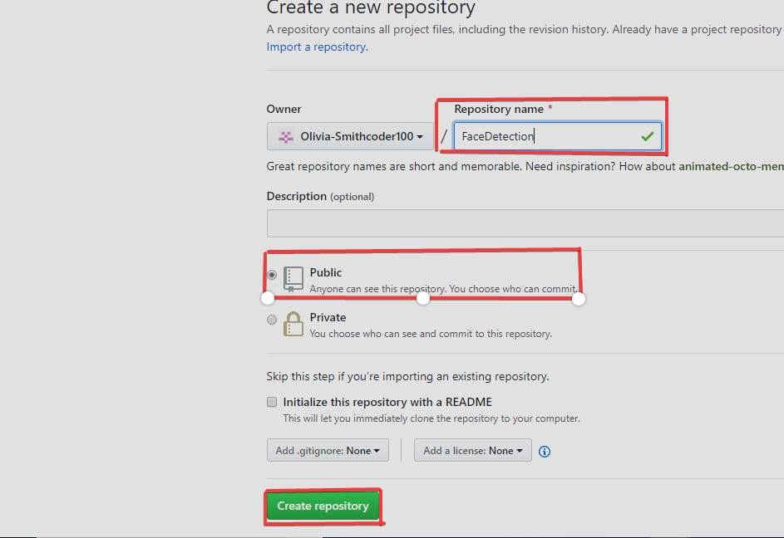
Creating a Repository
Before you can start using Git, you need to create a repository to store your code. A repository is essentially a folder that Git will track changes in. You can create a repository locally on your computer or on a remote server like GitHub.
Creating a Repository on GitHub
To create a repository on GitHub, simply navigate to your profile page and click on the 'New repository' button. You'll be prompted to enter a name and description for your repository, and you can choose whether to make it public or private.

Slide 6
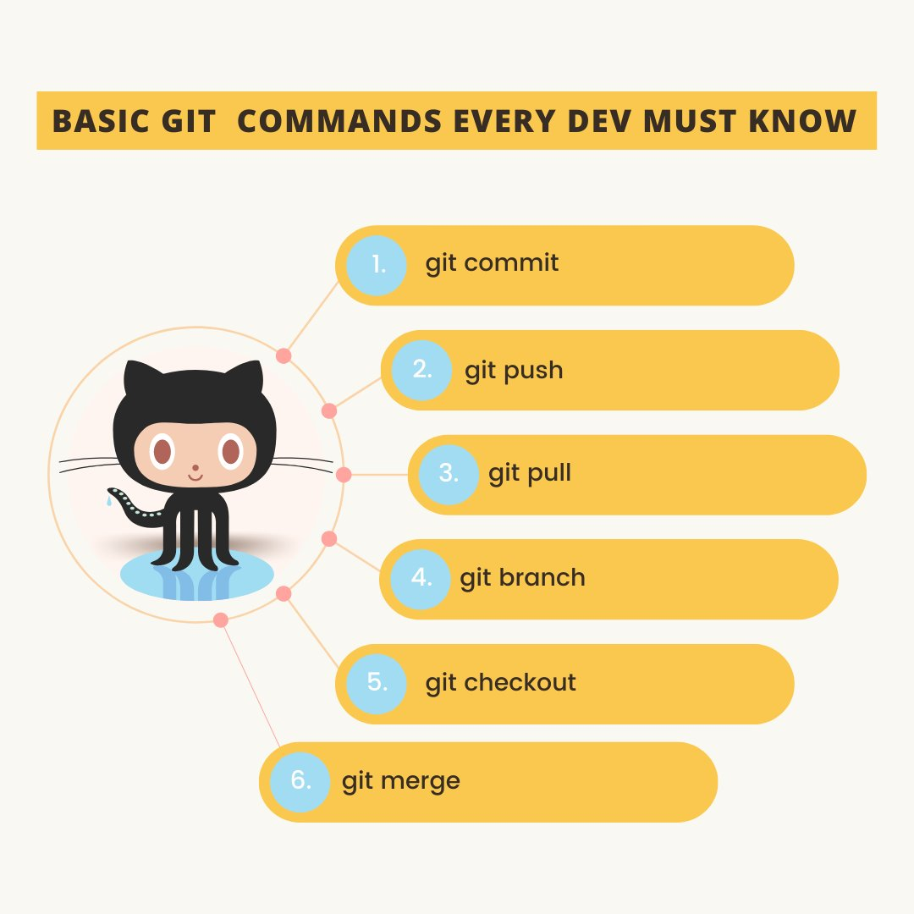
Basic Git Commands
git init
Initializes a new Git repository in the current directory.
git commit
Commits the changes in the staging area to the repository, with a message describing the changes.
git add
Adds changes to the staging area, ready to be committed.
git status
Displays the current status of the repository, including changes that have been staged or committed.

Slide 7
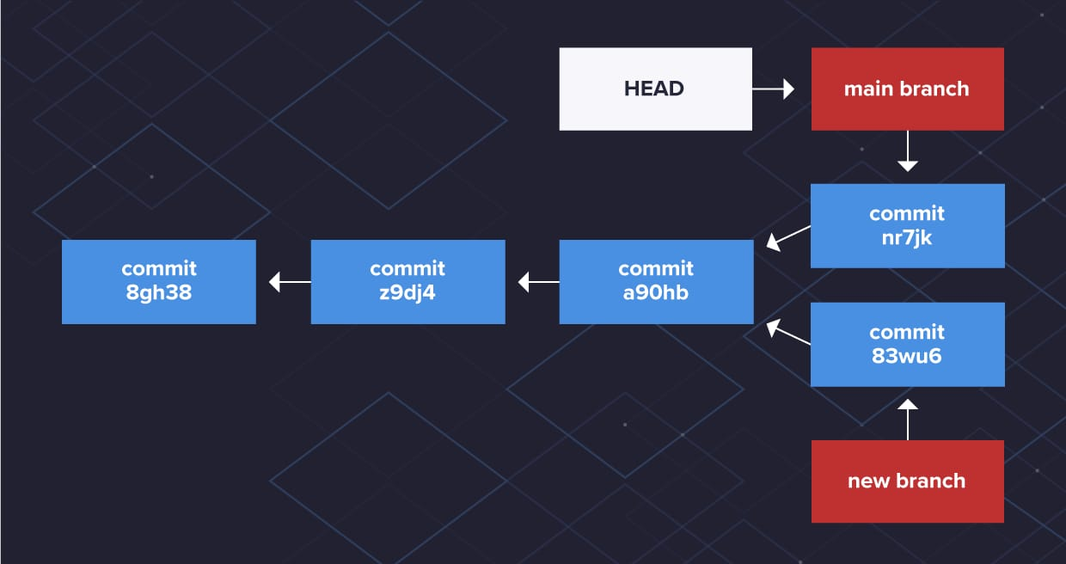
Branching and Merging
Branching
Creating a new branch allows you to work on a feature or bugfix without affecting the main codebase. Use the command "git branch [branch-name]" to create a new branch, and "git checkout [branch-name]" to switch to it.
Merging
Once you have completed your work on a branch, you can merge it back into the main codebase using the "git merge [branch-name]" command

Slide 8
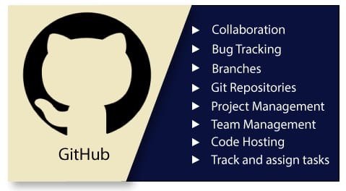
What is GitHub?
GitHub is a web-based platform that provides a hosting service for Git repositories. It offers a range of features that make it easy to collaborate with others and manage version control for projects. With GitHub, you can easily share your code with others, track changes and issues, and work together on projects in real-time.

Slide 9
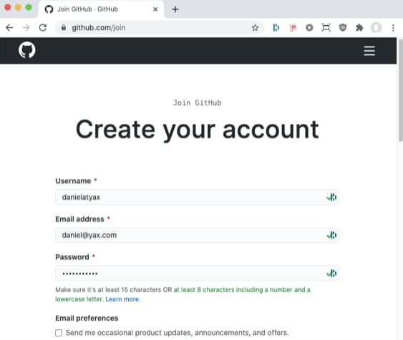
Creating a GitHub Account
To create a GitHub account, go to the GitHub website and click on the "Sign up" button in the top right corner.
You will be prompted to enter your email address, a username, and a password.
Once you have entered your information, click on the "Create an account" button.
You will receive an email from GitHub to verify your email address. Follow the instructions in the email to complete the verification process.
Once you have verified your email address, you can start using GitHub to collaborate with others and manage your code repositories.

Slide 10
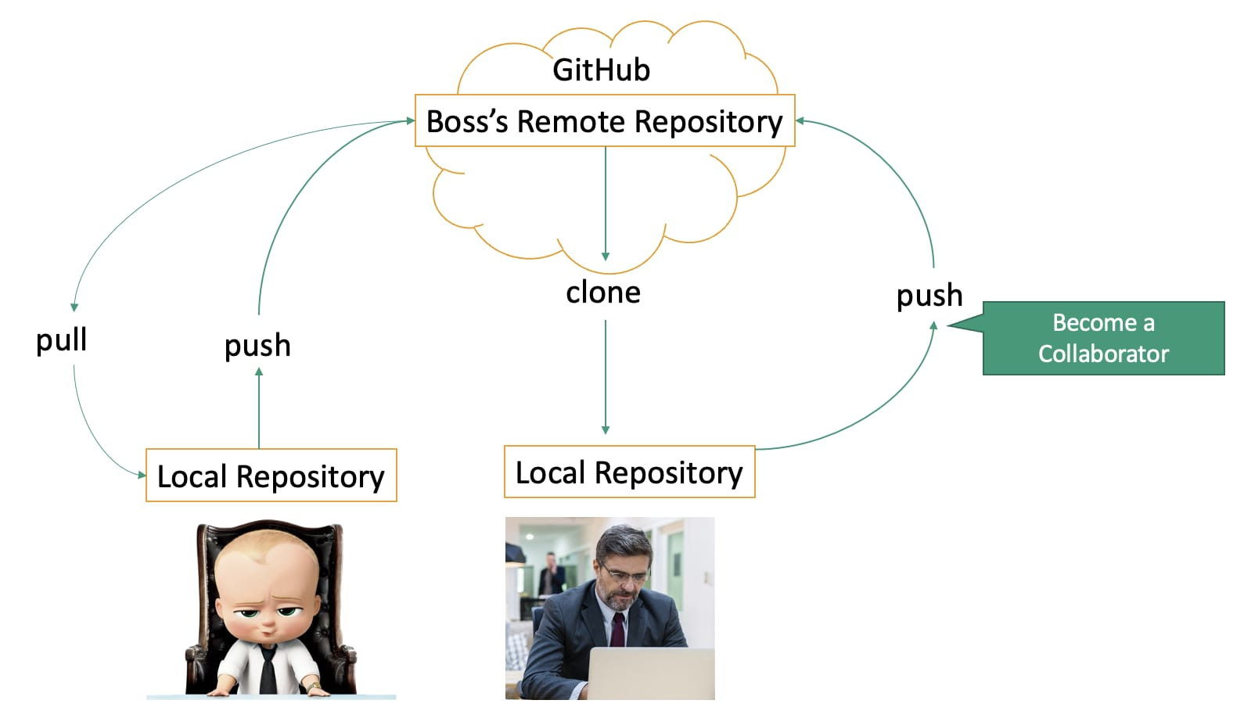
Pushing to GitHub
Pushing to GitHub
Once you have added the remote repository, you can push your changes to GitHub using the "git push" command.
Pull Requests and Code Reviews
After pushing your changes to GitHub, you can create a pull request to merge your changes into the main branch. This allows for code reviews and collaboration with other contributors.

Slide 11
Thank you

